Slide 1
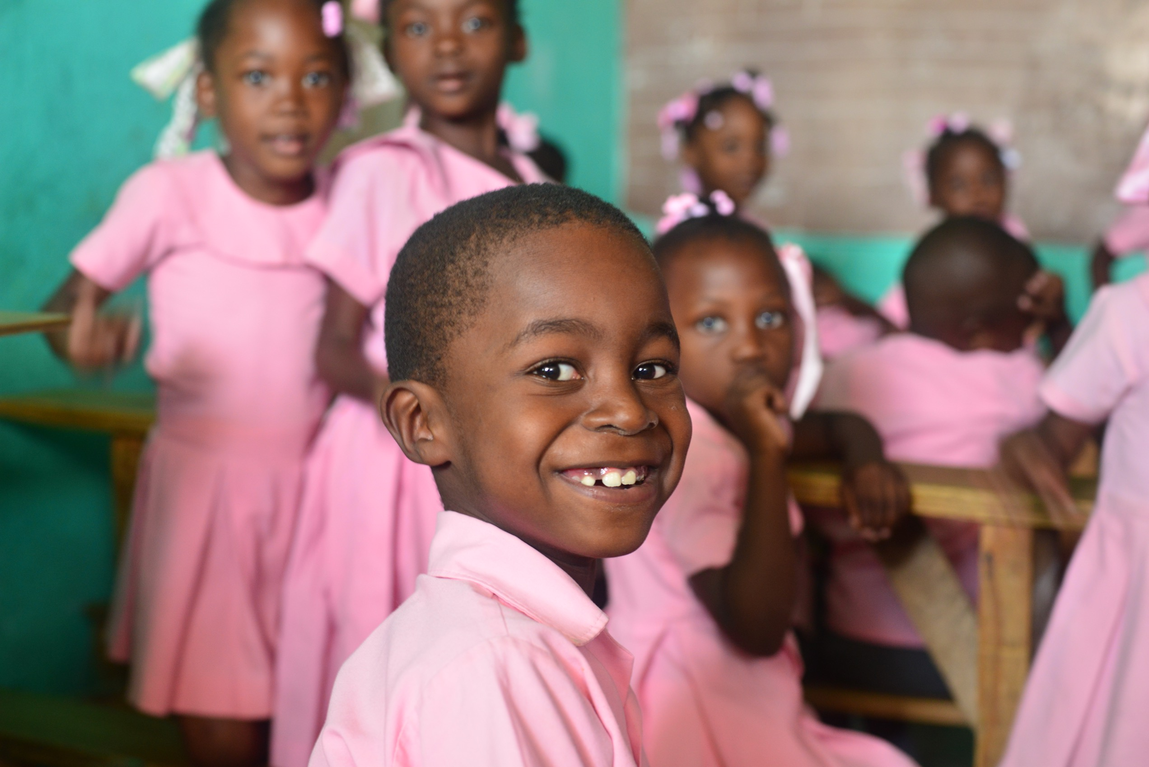
Who we are
Organizational Overview

Slide 2
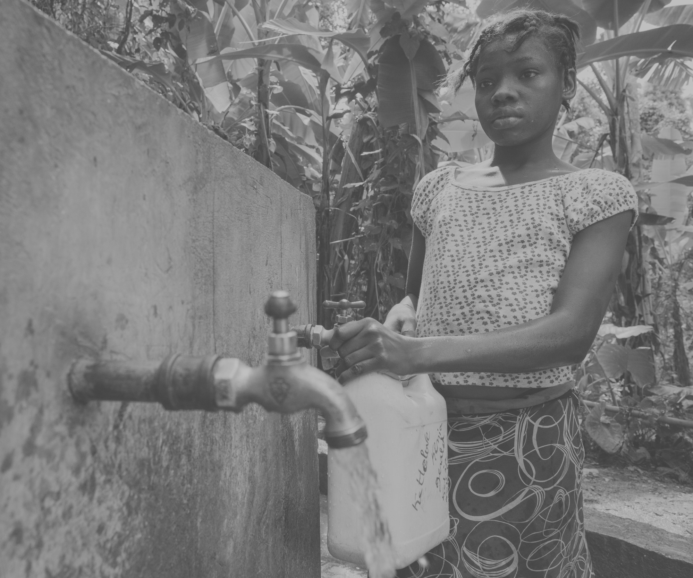
250,000,000
Multiple Challenges across LAC
Vulnerable or excluded
250,000,000 financially and digitally excluded
Disproportionately vulnerable: Women, children and marginalized groups
7 of 20 most disaster-exposed countries in the world are in LAC
33% of global homicides are in LAC (with 9% of the global population)
Erosion of democratic norms in many countries, along with rise in populism
High levels of corruption
Increasing migration
2
Notes:
Poverty statitics: Updated, Per WB data and using the WB definition of less than US$4-a-day throughout their lives.
Source: “Vakis, Renos; Rigolini, Jamele; Lucchetti, Leonardo. 2016. Left Behind : Chronic Poverty in Latin America and the Caribbean. World Bank. https://openknowledge.worldbank.org/handle/10986/21552 License: CC BY 3.0 IGO.”
The World Bank classifies poverty as people living on less than $4 per day, vulnerable populations as those living on $4 to $10 a day, middle income as living on $10 to
$50 per day, and the rich as living on $50 or more per day.
(2) Source: Pending (3) Source: Pending
(3) Source: Igarapé Institute a think and do tank. Citizen security and Latin America: Facts and Figures. (2018) https://igarape.org.br/wp-content/uploads/2018/04/Citizen-Security-in-Latin-America-Facts-and-Figures.pdf

Slide 3
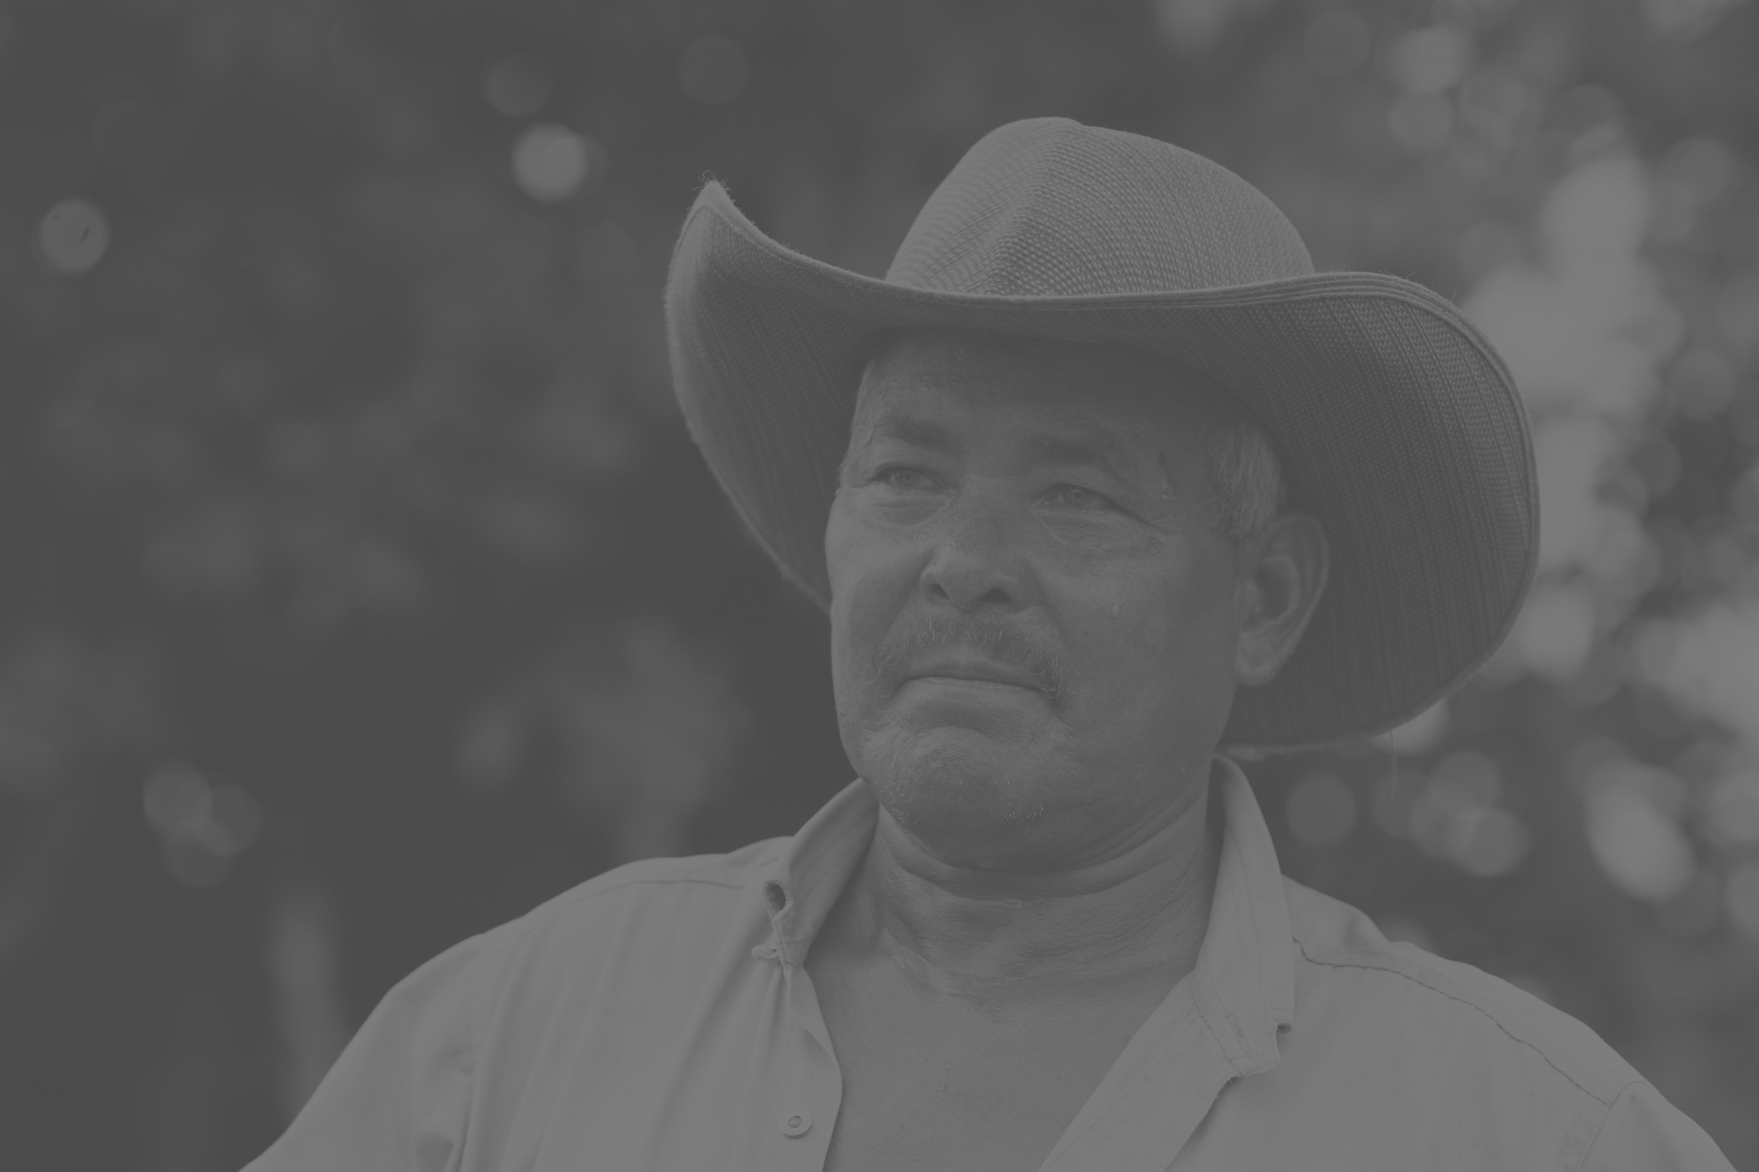
Urban & older
Critical Trends in LAC to 2030
…and able to solve issues?
85-90% urban by 2030 – all needing services/infrastructure
Demographic window closing => fewer workers than dependents
High informal employment (average 35% in 2030)
Lagging infrastructure and education investments
Rising threat of pandemics and increased burden of chronic diseases
Outward migration and remittances
3
Notes:
Note constrained public health systems

Slide 4
One Vision A just, peaceful, and prosperous hemisphere in which all people have meaningful opportunities to thrive.
Thriving
Surviving
Regional issues
Corruption, human trafficking, disease, disasters, poverty, inequality, unemployment, malnutrition, violence, migration, exclusion, mortality, food security, illiteracy, environmental degradation, wasted resources, illicit trade, etc.
4

Slide 5
Implementing Our Vision
Thriving
Just, peaceful, prosperous, resilient, and sustainable
We seek to empower and include vulnerable and marginalized groups
We seek sustainable solutions to complex development issues
Empowerment, inclusion
Surviving
Vulnerable/excluded:
Economically, politically, socially
5

Slide 6
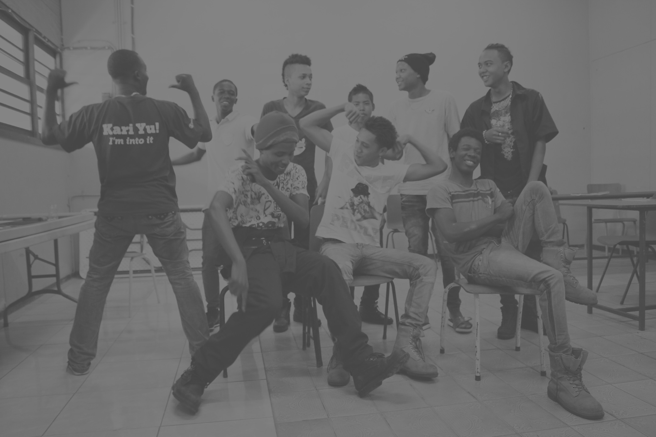
Solutions that Target Key Human Development Issues Across the Hemisphere
6

Slide 7
PADF secret sauce
OAS Partnership: we are part of the inter-American system while remaining an independent 501©3.
Ability to work at all levels and articulate partnerships: with and across public and private sectors and civil society; from policy-makers through community-led development.
Nearly 60-year of experience and knowledge of the region and of sustainable development, and our deep commitment to a just, peaceful, and prosperous hemisphere.
Flexibility and nimbleness: fast, cost-effective, practical, with strong governance.
1
7

Slide 8
Cross Cutting Themes throughout PADF’s work
Multi-stakeholder partnerships: Unlock private, public, and community innovation & entrepreneurship.
Gender: Use gender lens in program design and implementation to improve women’s and girls’ empowerment and equality.
Climate: Enable and promote community-driven climate adaptation and resilience on land and coastal areas. Drive climate-smart, sustainable, green practices in cities, water, energy, livelihoods, agriculture, natural resource management, and beyond.
Technology: Explore and leverage technologies and innovation to reach more people, more quickly, and more sustainably, for greater scale and lower cost.
8

Slide 9
Our Values
Honesty
Excellence
Accountability
Respect
Teamwork
9

Slide 10
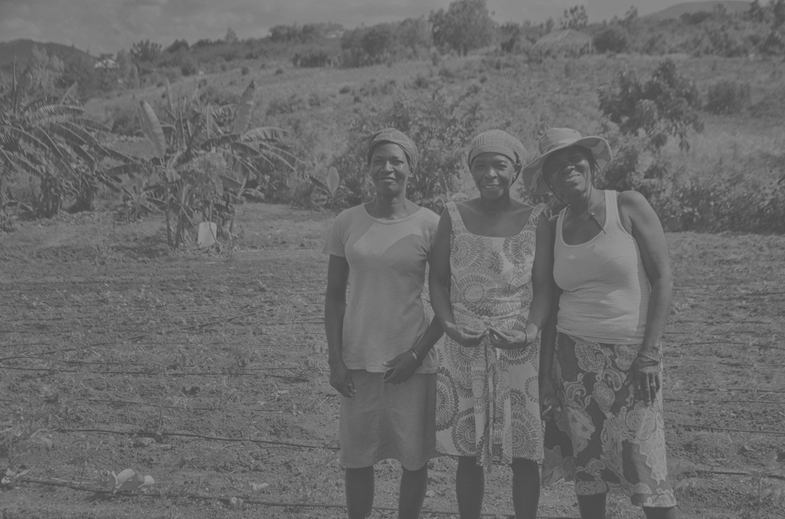
Higher-Purpose Statement
With courage, integrity, and care, we at PADF embrace our responsibility to co-create a future where each of us, our people and our planet, our communities and our institutions, can flourish.
We celebrate the Pan-American region’s magnificent diversity of peoples, languages, ethos, cultures, natural resources, and approaches.
10

Slide 11
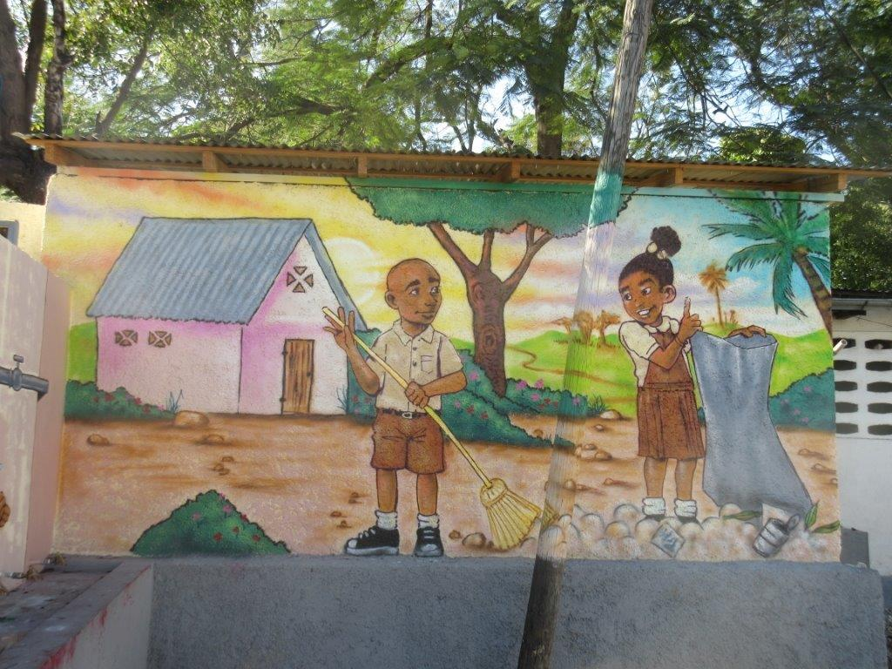
10.4 million
The Haiti Context
59% below the national poverty line
Poorest country in the Americas
90 percent of the population at risk of a natural disaster
One of the most unequal countries in the world,
with a Gini coefficient of 0.61 in 2012 (Sweden is 0.25)
Rank 182 out of 190 for Ease of Doing Business
11
Notes:
Poverty statitics: Updated, Per WB data and using the WB definition of less than US$4-a-day throughout their lives.
Source: “Vakis, Renos; Rigolini, Jamele; Lucchetti, Leonardo. 2016. Left Behind : Chronic Poverty in Latin America and the Caribbean. World Bank. https://openknowledge.worldbank.org/handle/10986/21552 License: CC BY 3.0 IGO.”
The World Bank classifies poverty as people living on less than $4 per day, vulnerable populations as those living on $4 to $10 a day, middle income as living on $10 to
$50 per day, and the rich as living on $50 or more per day.
(2) Source: Pending (3) Source: Pending
(3) Source: Igarapé Institute a think and do tank. Citizen security and Latin America: Facts and Figures. (2018) https://igarape.org.br/wp-content/uploads/2018/04/Citizen-Security-in-Latin-America-Facts-and-Figures.pdf

Slide 12
Nearly 40 Years in Haiti…
+50 M Trees Planted
+40,000 TIP Victims Helped
+100,000 Jobs Created
+2M Beneficiaries per year
…Promoting Resilience
23
12

Slide 13
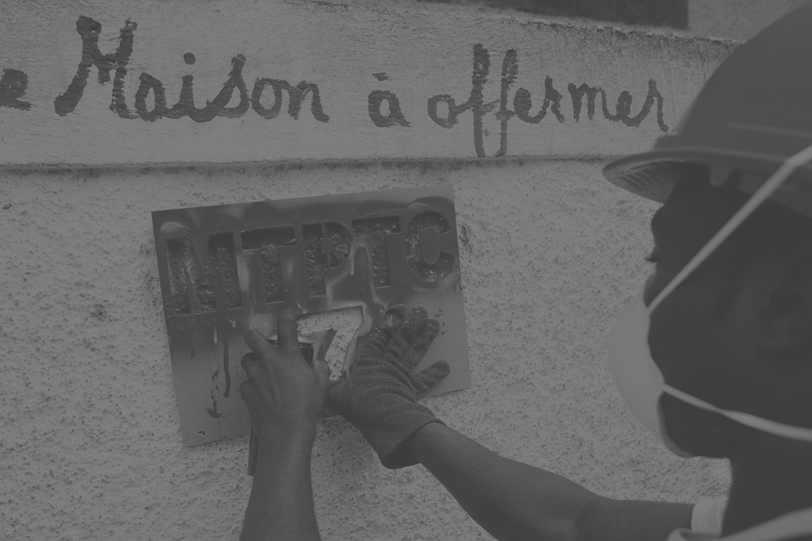
Haiti projects have spanned all of PADF’s thematic areas with a focus on the top two quadrants
13

Slide 14
Recent programs
Disaster Assistance & Reconstruction in the aftermath of the 2010 earthquake, PADF launched immediate response efforts and long-term reconstruction programs. (OFDA, Caterpillar Foundation)
Entrepreneurship: we supported rebuilding the private sector by identifying promising entrepreneurs, selecting them via a Business Plan Competition, and unlocked private investment capital via Leverage model to create jobs and economic growth. (USAID)
Urban Resilience: we upgraded neighborhoods in Delmas 32, introduced multi-level housing in dense but poor communities, and promoted disaster risk-reduction. These infrastructure upgrades promote economic opportunities and self-reliance. (World Bank)
1
14

Slide 15
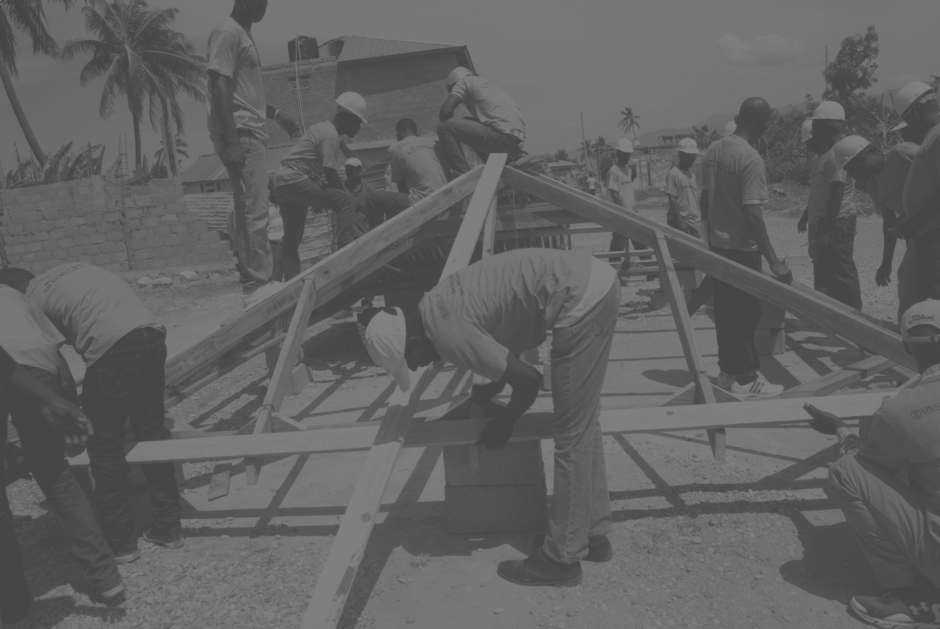
Current work with USAID
Hurricane-Matthew Recovery Building Back Safer after Hurricane Matthew with technology and local actors (drones, e-vouchers, vendors and construction workers) to build safer shelters, rebuild WASH and restore energy access. Our work builds community knowledge and assets to aid self-recovery against future natural events.
Capacity-building (Small Grants Facility) a mechanism to build local capacity and support self-reliance, engaging local partners (private and NGO) to reach development goals.
First activity: Reforestation
Potential new activities could include (with potential new funding from other donors): WASH, Energy, Gender, STEM, Transparency & Anti-Corruption
Local Governance supporting 15 communes in building or refining their commune development plan and supporting a transparent process for selecting priority projects (WASH, Education, Environmental Risk Reduction) and engaging private sector service providers.
15

Slide 16
Current work (continued)
Urban Resilience. Working closely with vulnerable groups in Martissant and Ouanaminthe to support disaster risk reduction, WASH, safer shelters, and increasing self-reliance (USAID).
Community Violence Reduction. Empowering women and at-risk youth, giving them job & life skills with entrepreneurship training, financial literacy, establishing savings groups, and encouraging reporting of GBV crimes (UN).
1
16

Slide 17
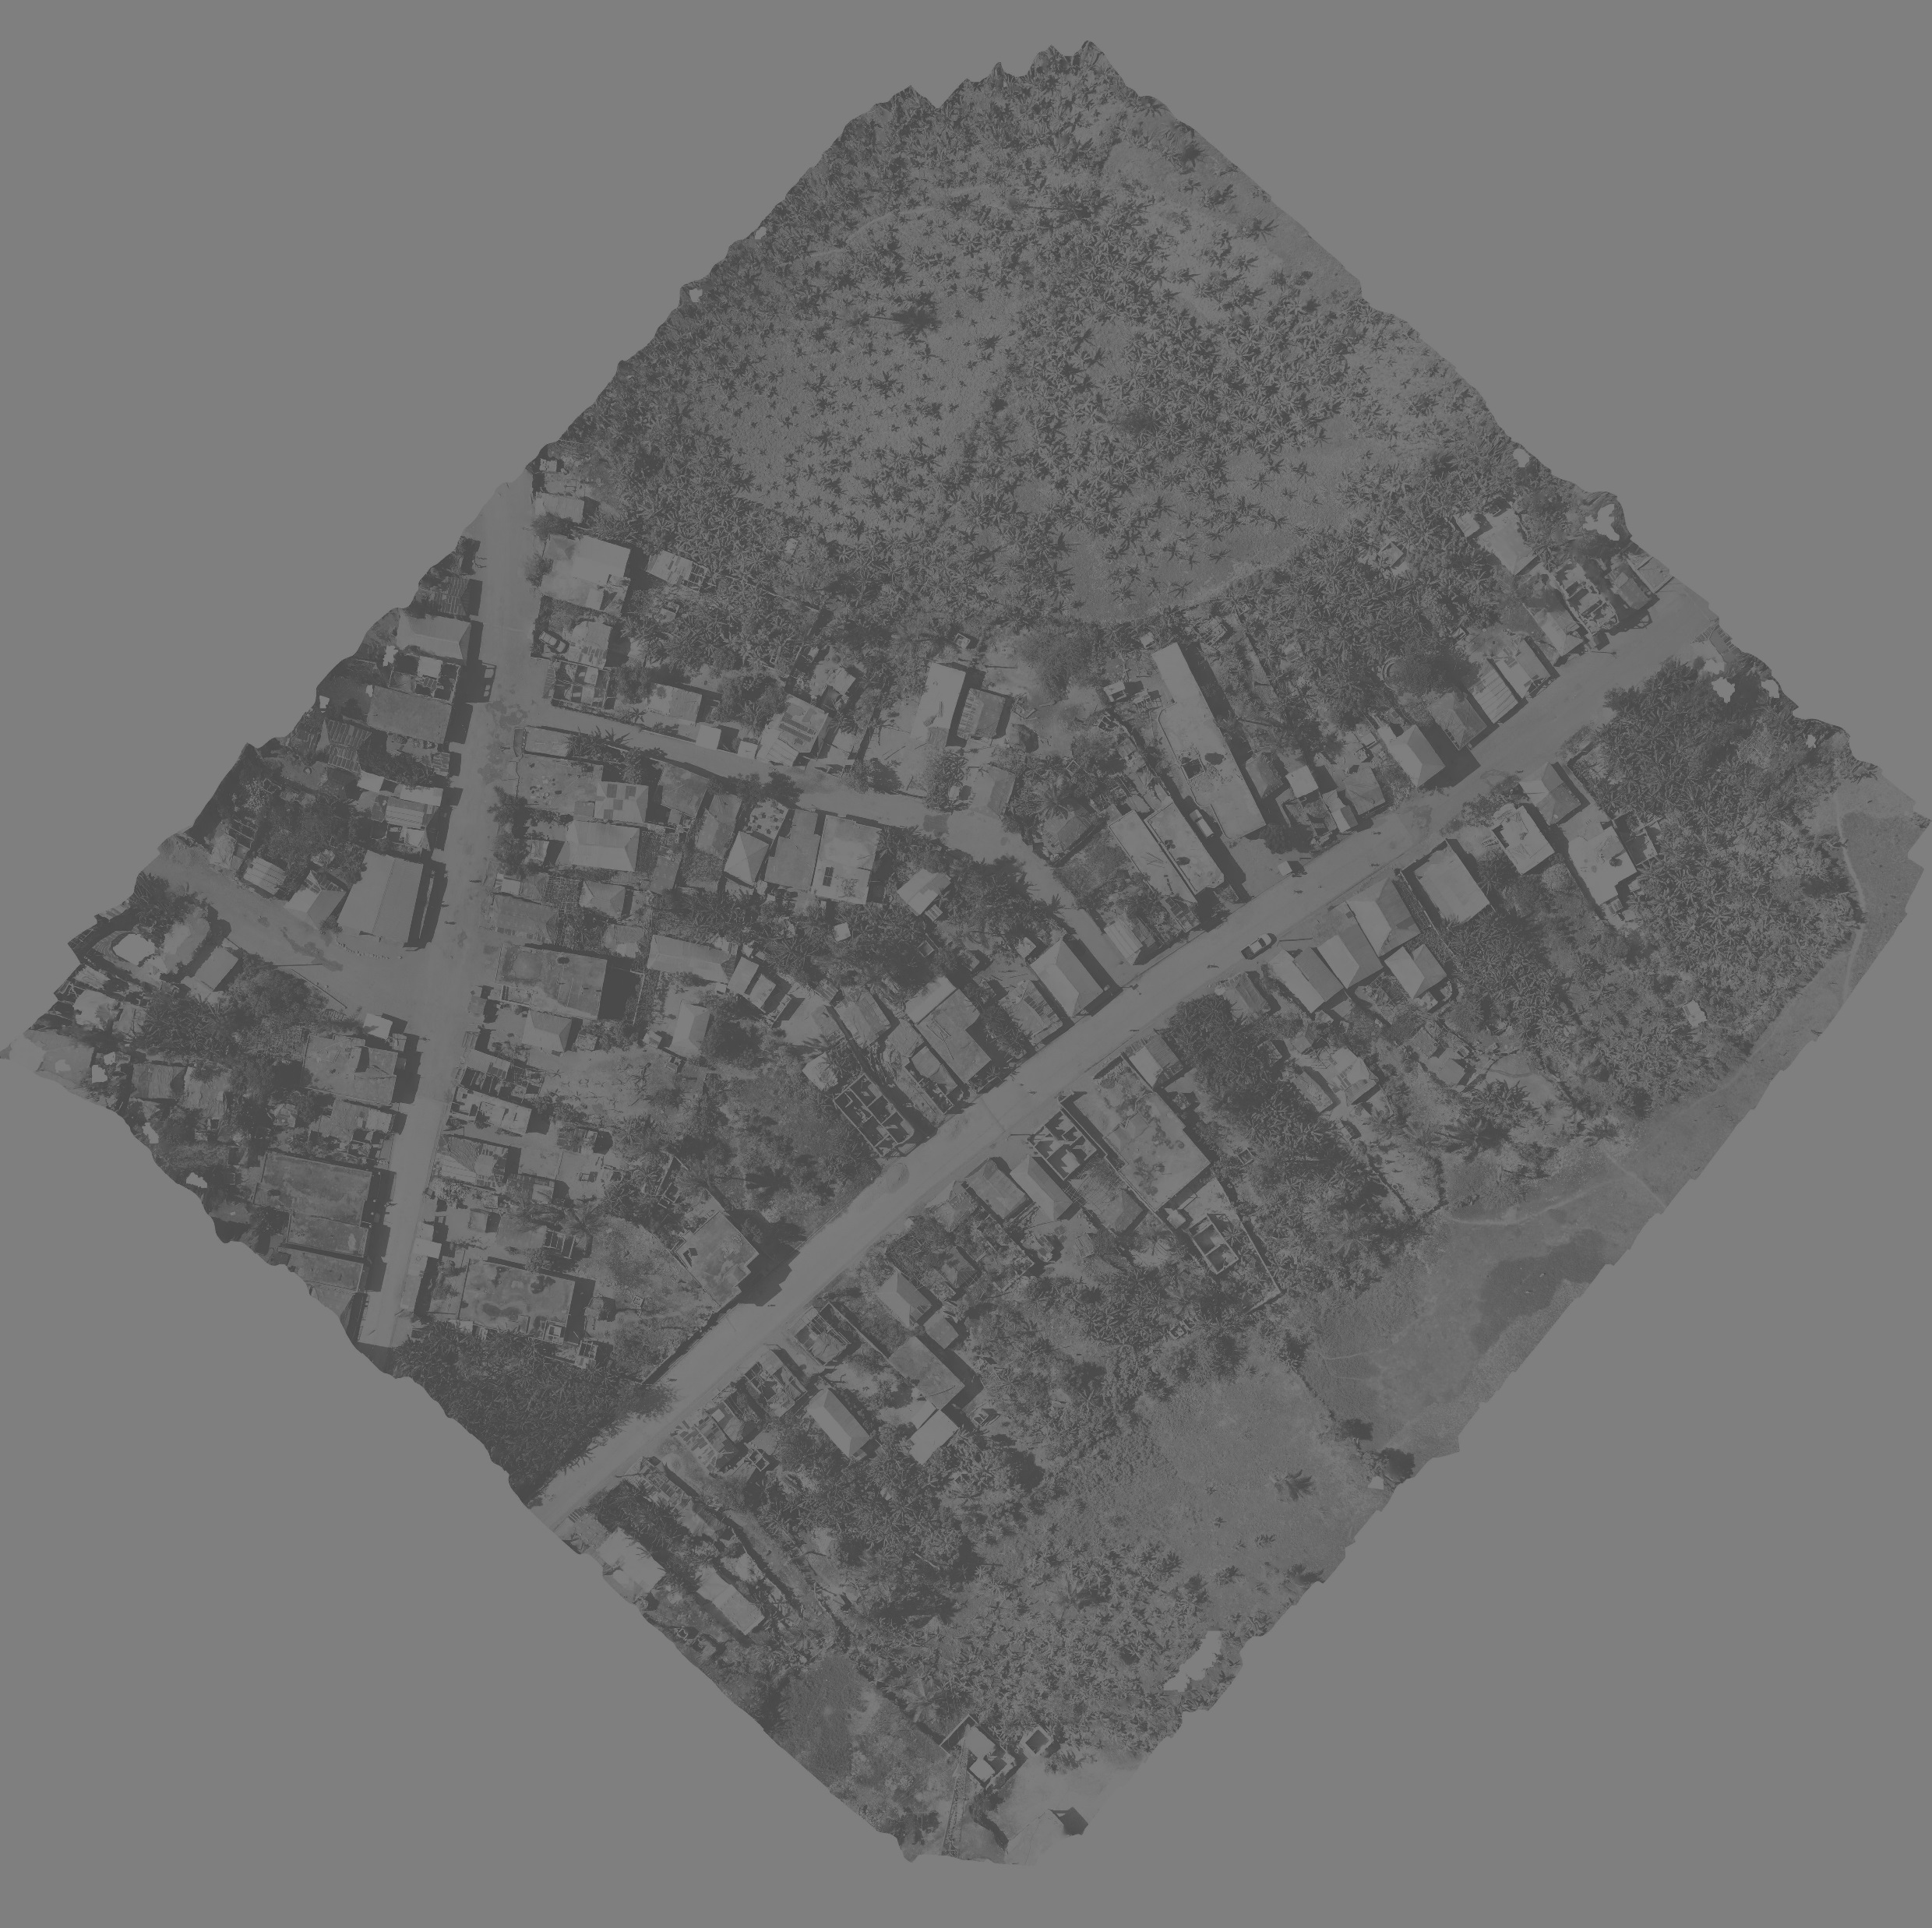
Innovation & Technology thanks to USAID
Drones and open-source data platforms for better and faster data, particularly in disaster-response, we use drones, app-based surveys, e-vouchers, and mapping to analyze the damage, build 3D models for repair, and accurately identify the most vulnerable populations who need assistance with their self-recovery efforts.
Blue Economy to promote sustainable livelihoods with sustainable oceans and coastal areas; we support transformational business models, e.g. creating new products from ocean-bound plastic waste (won IDB’s Blue Tech Challenge).
Online portal to track progress on ongoing projects, promoting transparency and supporting public-private partnerships.
17

Slide 18
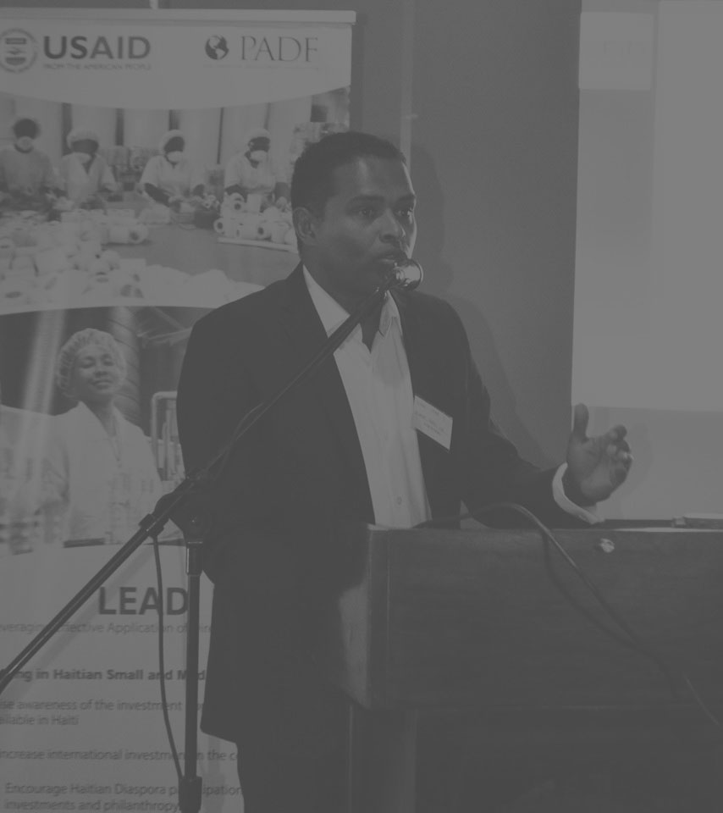
Partnership approach
Donors ideation, creative solutions, communication
Government priorities, build capacity
Private sector leverage, resources
Diaspora philanthropy, remittances
Local organizations sustainability
Media visibility
18

